Slide 1
ONLINE BANKING SYSTEM WITH FINANCIAL TOOLS
Presented by :
Pranav
Tamil
Aleena
Ananthan

Slide 2
AGENDA
03
PROJECT OVERVIEW
06
TOOLS OVERVIEW
09
TESTING STRATEGY
04
WHY THIS PROJECT?
07
CALCULATOR
10
SNAPSHOT
05
WORKFLOW
08
FOLDER STRUCTURE
14
DEMO

Slide 3
PROJECT PURPOSE
At UST Bank, security and convenience are paramount.
Register and log in
Operations
Finance_tools
ML Loan Estimator
Aim: all-in-one banking

Slide 4
Architecture
online_banking/ ├─ accounts/ ├─ bank/ ├─ tools/ ├─ ml_model/ ├─ templates/ └─ tests/

Slide 5
WORKFLOW
Customer Workflow
Input Financial Data
Select Tool
Get Results
Plan Finances
2. Employee Workflow
Execute Calculations
View customers
Vault balance
3. Banking Operations
Investment Planning
Deposit
Withdraw

Slide 6
TOOLS OVERVIEW
EMI Calculator
SIP Calculator
FD Calculator
RD Calculator
Retirement Savings Estimator
Home Loan Eligibility
Credit Card Interest Calculator
Taxable Income Calculator
Budget Planner
Net Worth Calculator
Layer | Technology
Language | Python 3.9+
Framework | Django 4.x
Database | MySQL 8
Frontend | Bootstrap 5
ML | Scikit-learn/XGBoost
Testing | unittest
Version Control | GitHub

Slide 7
CALCULATOR
EMI Calculator:
Input: Principal, rate, tenure.
Output: Monthly instalment.
SIP Calculator:
Input: Monthly investment, rate, tenure.
Output: Future corpus.
FD Calculator:
Input: Lump-sum deposit, rate, tenure.
Output: Maturity amount (quarterly compounding).
RD Calculator:
Input: Monthly deposit, rate, tenure.
Output: Maturity value (quarterly compounding).
Retirement Estimator:
Input: Current savings, monthly additions, rate.
Output: Future corpus.
Home Loan Eligibility:
Input: Income, expenses, rate, tenure.
Output: Max loan amount (40% of disposable income).
Credit Card Interest:
Input: Balance, rate, minimum payment %.
Output: Outstanding balance after N months.
Taxable Income:
Input: Gross income, deductions.
Output: Taxable income (non-negative).
Budget Planner:
Input: Income, expenses.
Output: Savings/investment suggestions (20%/30% split).
Net Worth Calculator:
Input: Assets, liabilities.
Output: Net worth (assets – liabilities).

Slide 8
Machine Learning Loan Estimator
- Features
- Saving the Model
- Integration with Django

Slide 9
TESTING STRATEGY
1. Unit Testing
Scope:
All 10 financial calculation functions (calculate_emi(), calculate_sip(), etc.)
Core banking operations (input validation, edge cases)
Tools:
Python's unittest framework
Coverage:
Target ≥80%
Test both success and error paths
Test Cases per Function:
Normal Case: Valid inputs (e.g., calculate_emi(100000, 10, 120))
Edge Case: Invalid inputs (e.g., calculate_emi(-100000, 10, 120) → ValueError)
2. Integration Testing (Django)
View Tests:
Test HTTP responses (e.g., GET /emi-calculator/?principal=100000&rate=10&tenure=120)
Validate template rendering
Form Tests:
Input validation
Form submission → correct calculation output
Tools:
Django TestCase

Slide 10
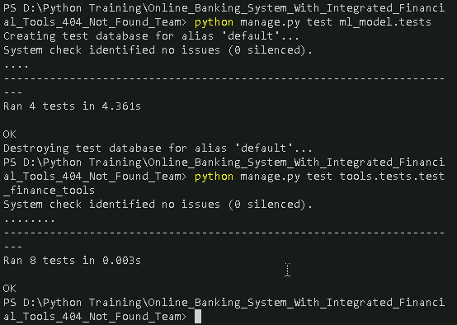
TESTING SNAPSHOT

Slide 11
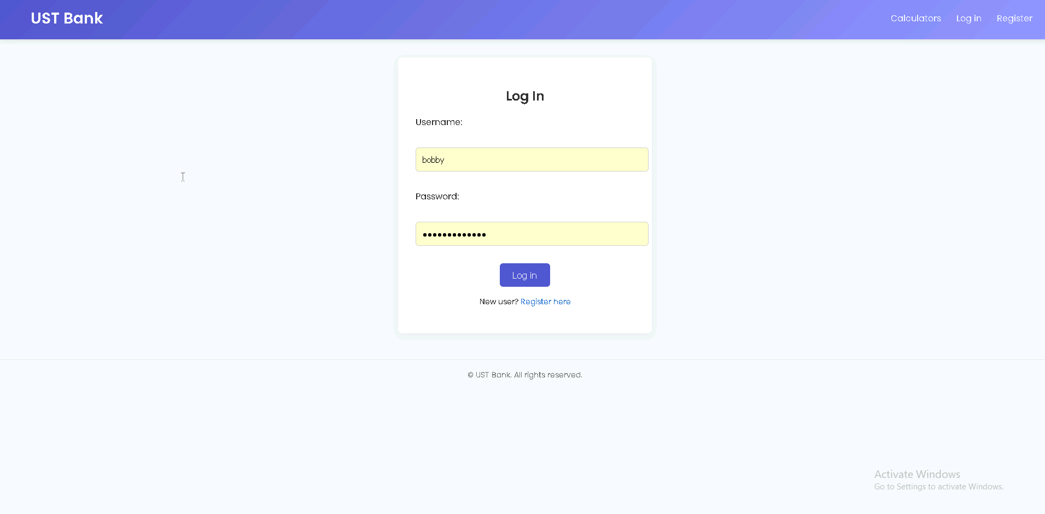
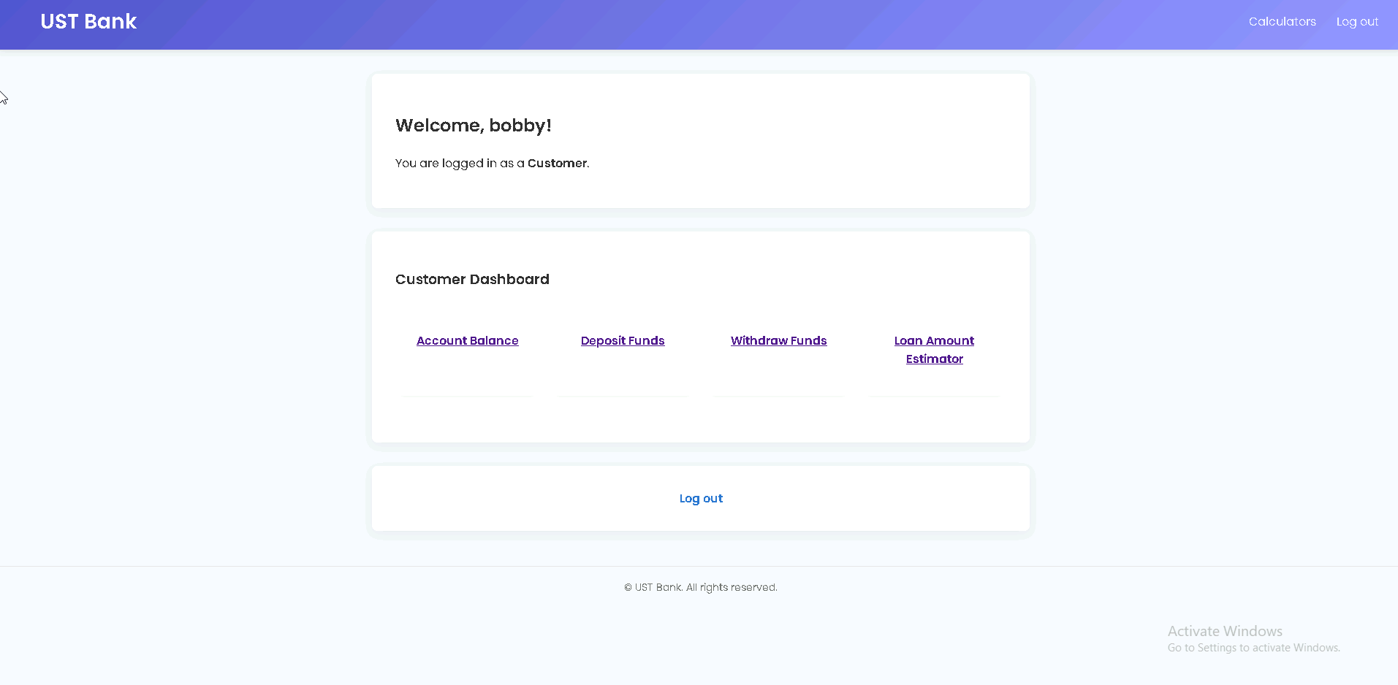
SNAPSHOT

Slide 12
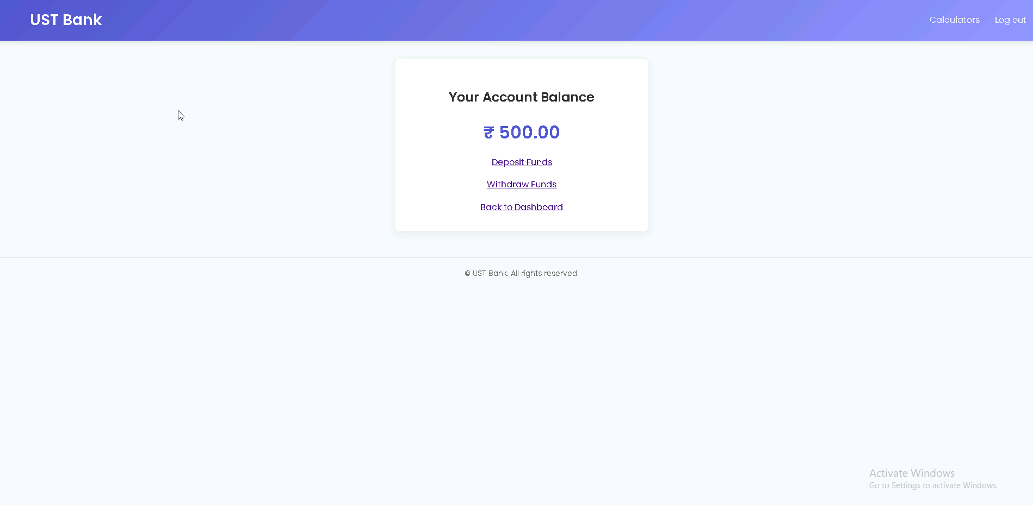
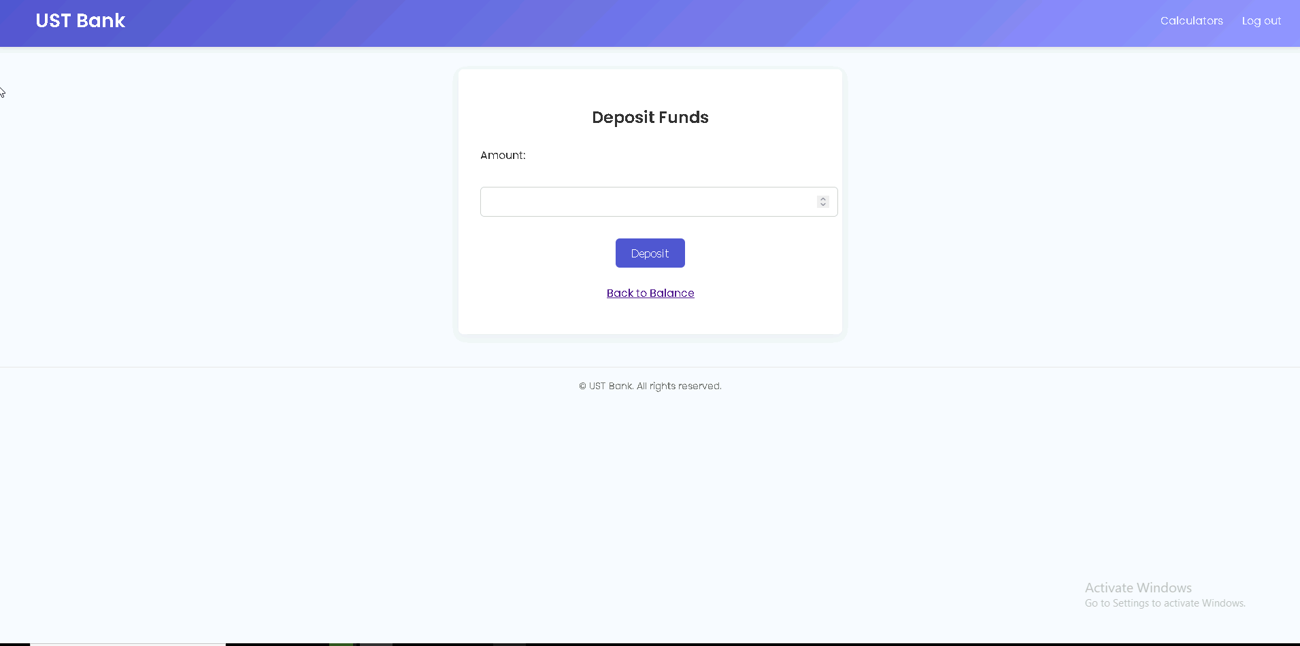
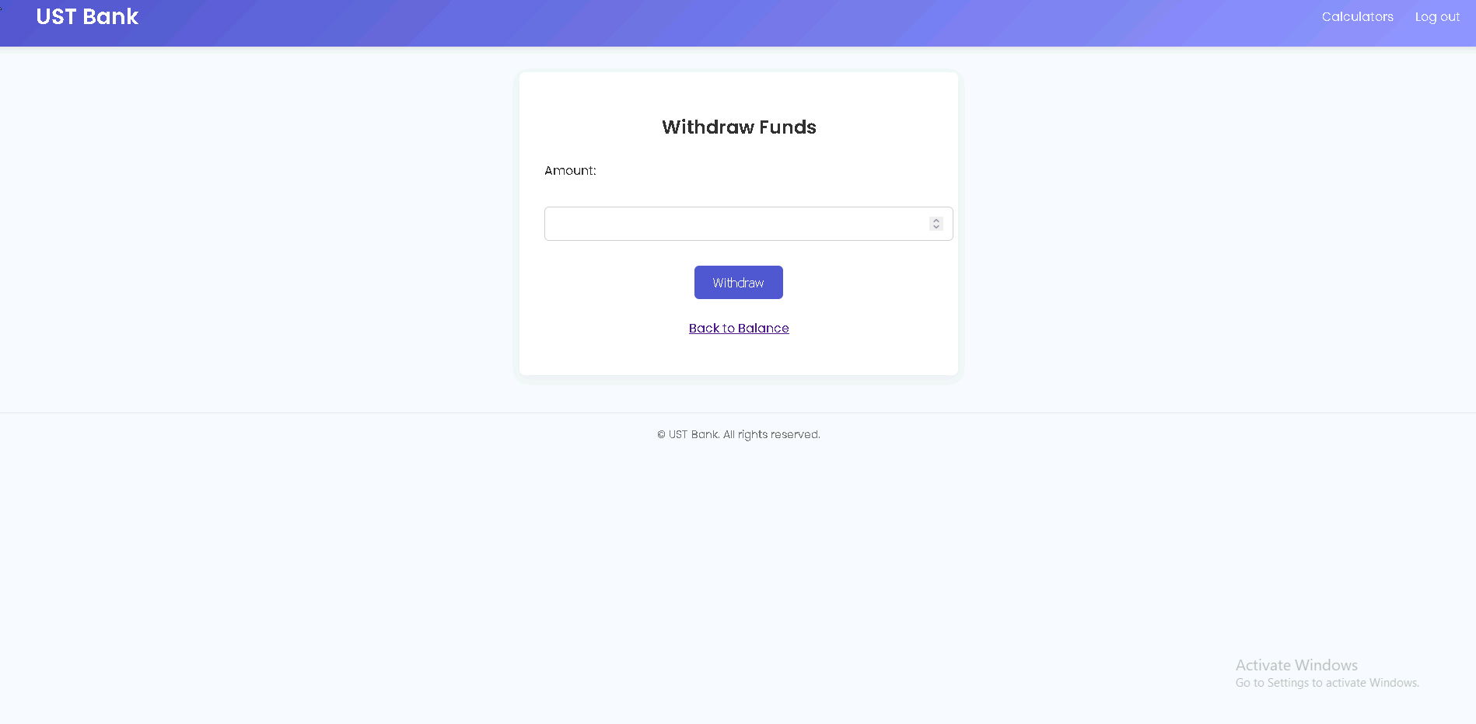
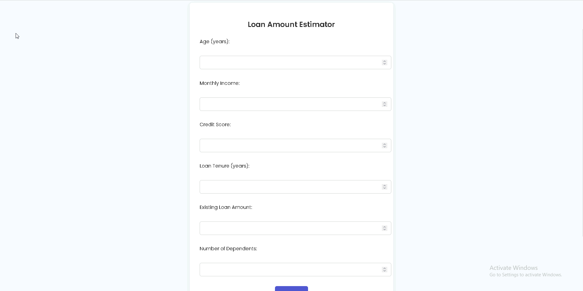

Slide 13
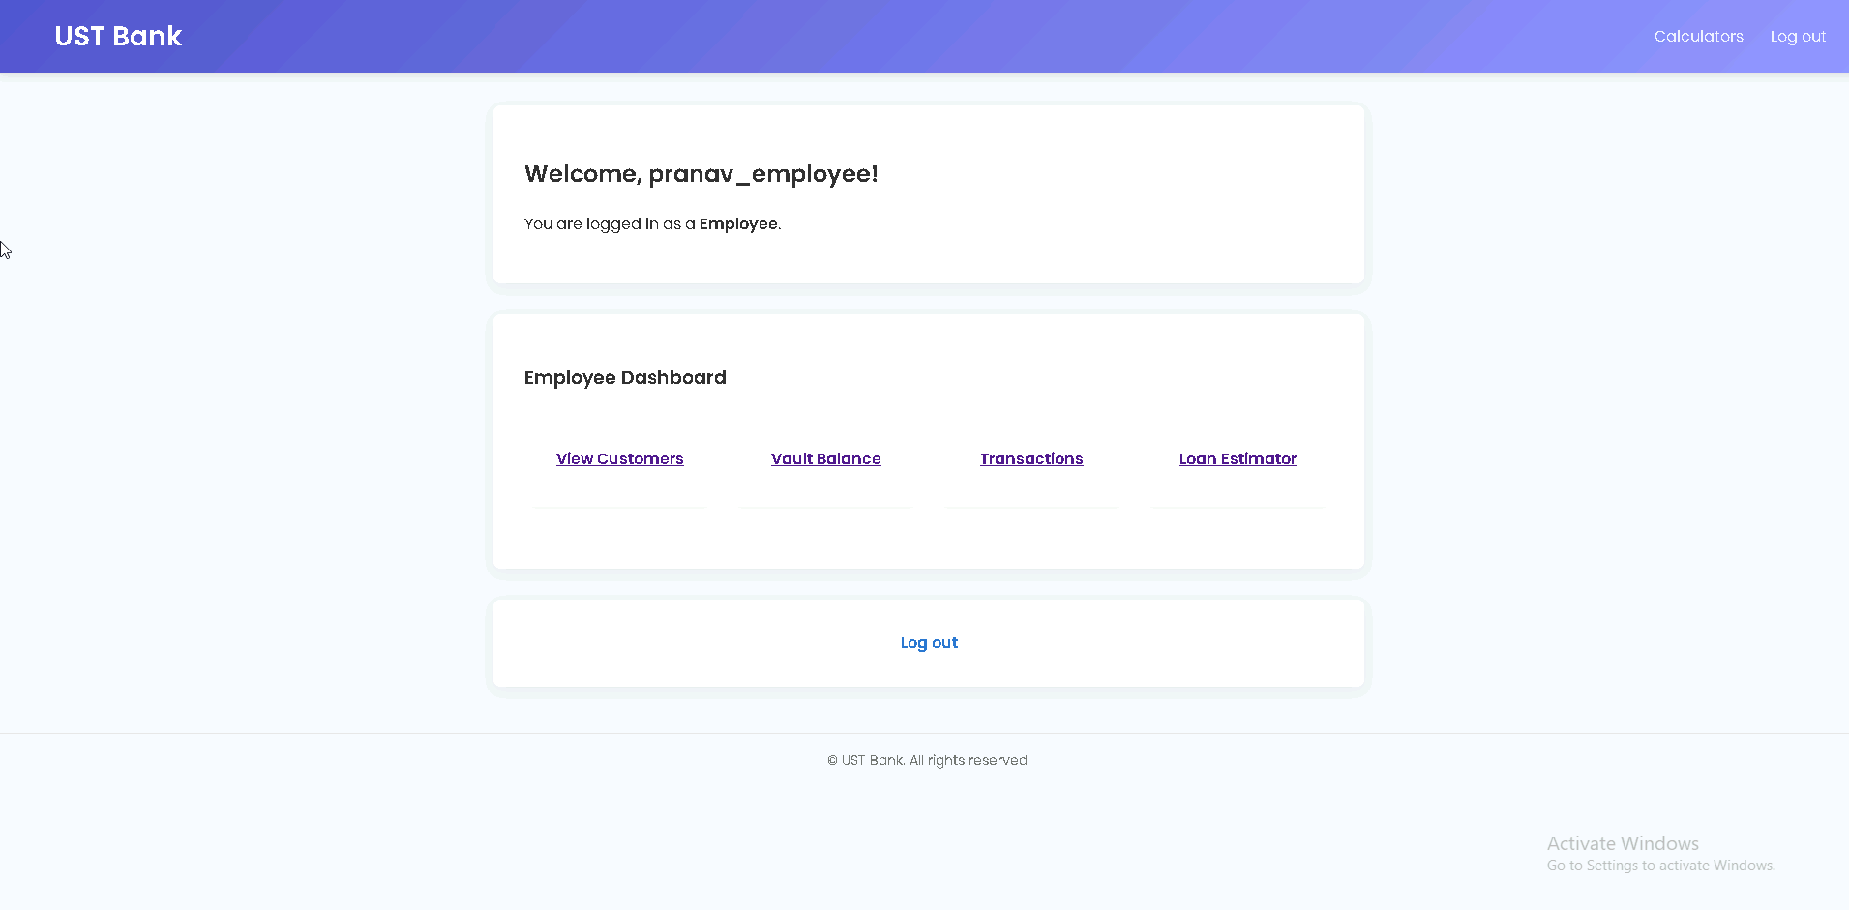
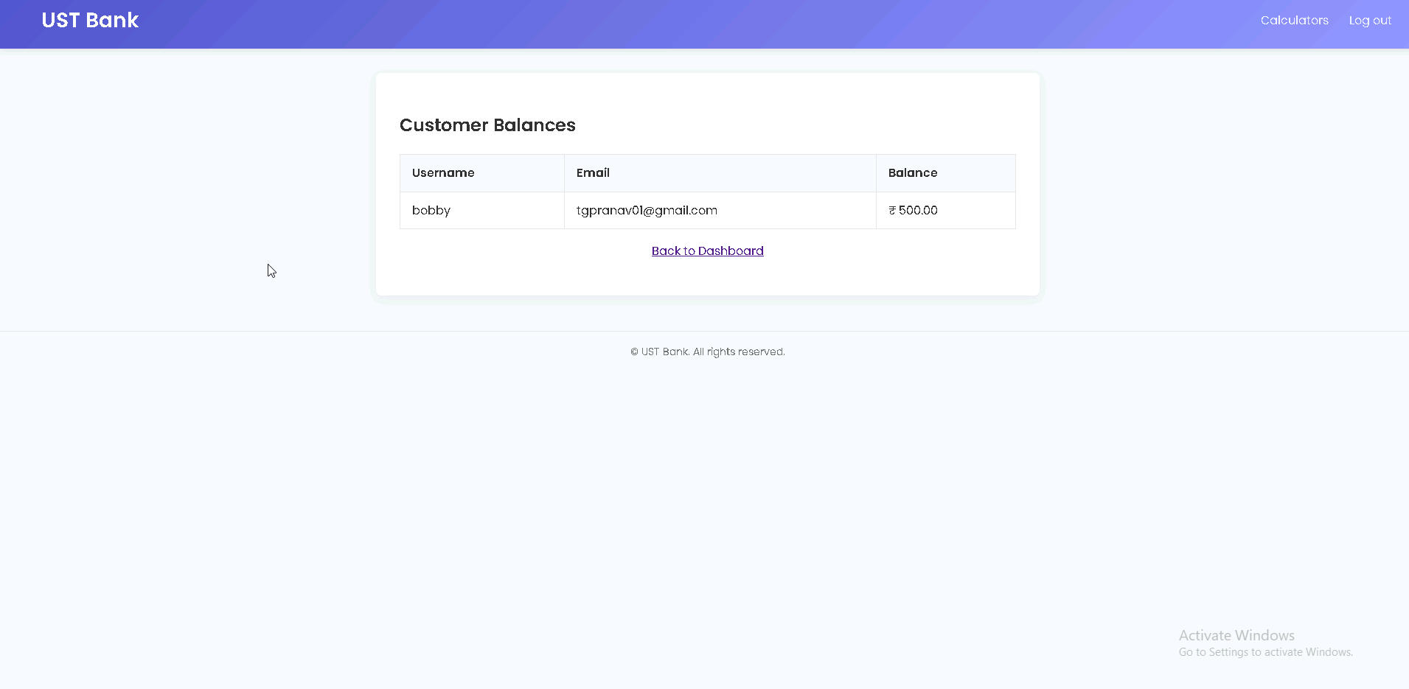
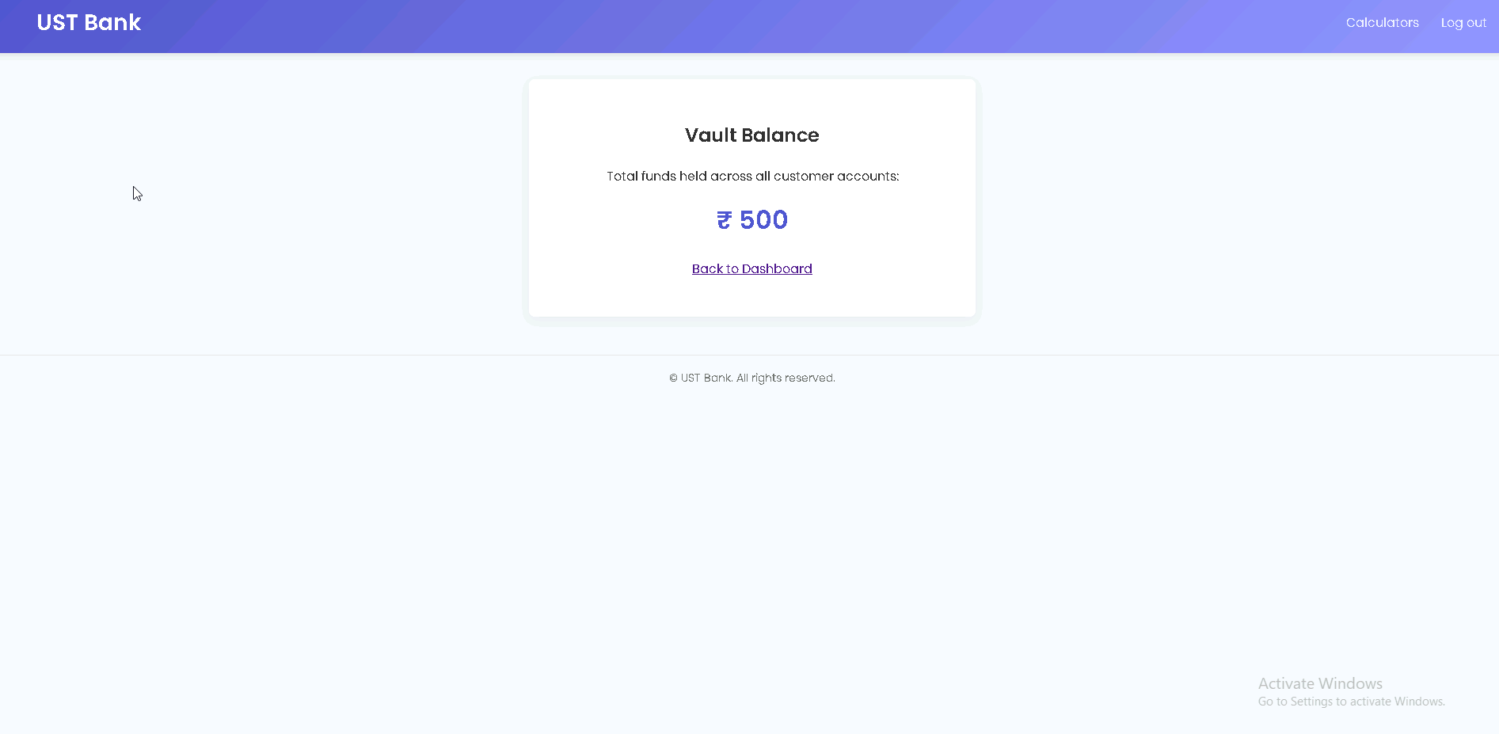
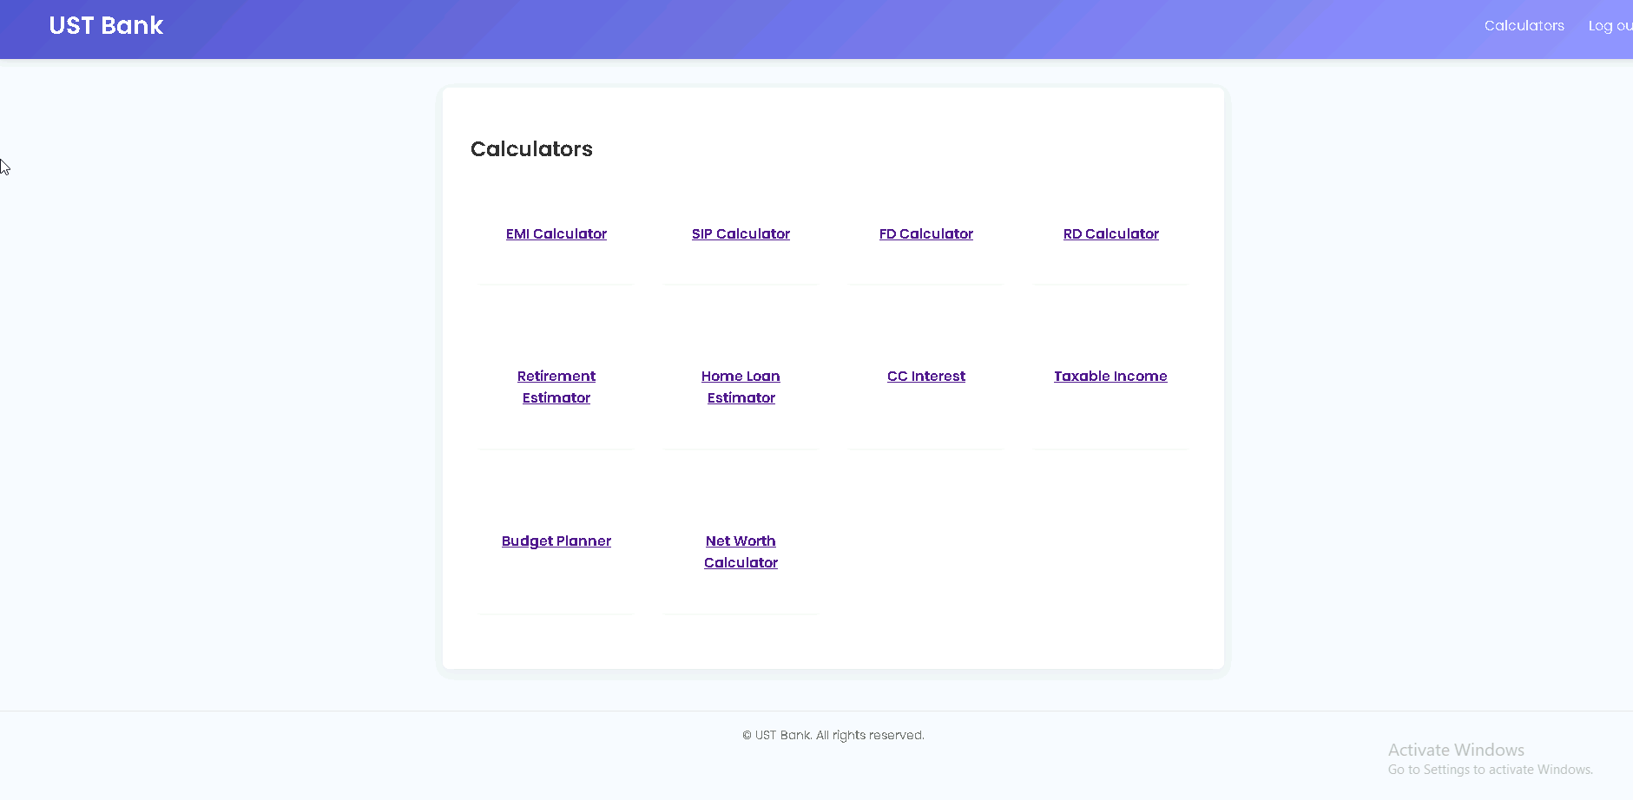

Slide 14
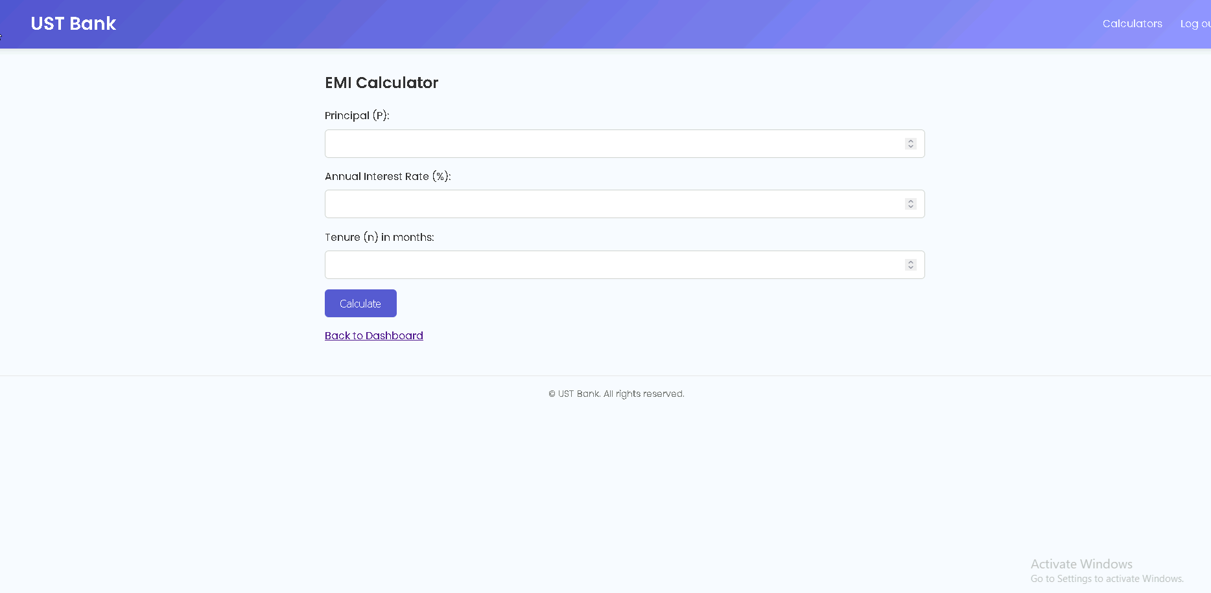
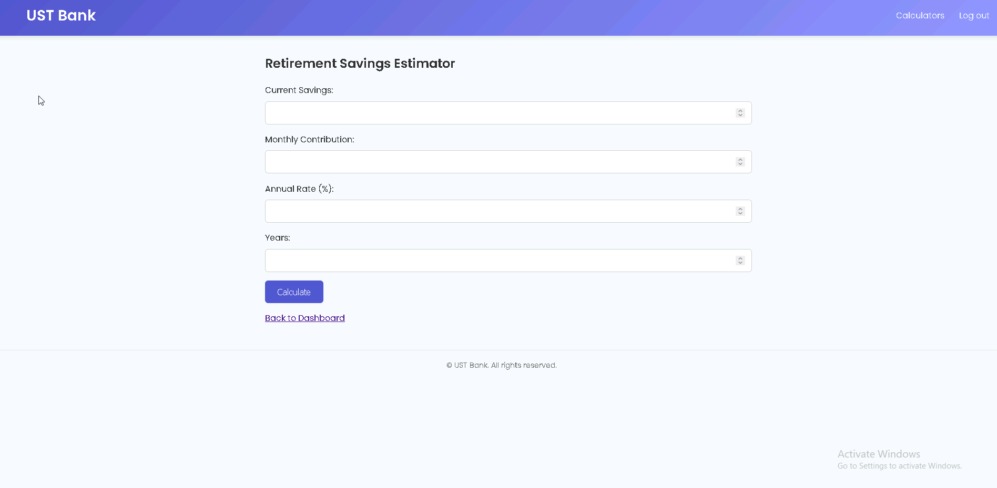

Slide 15
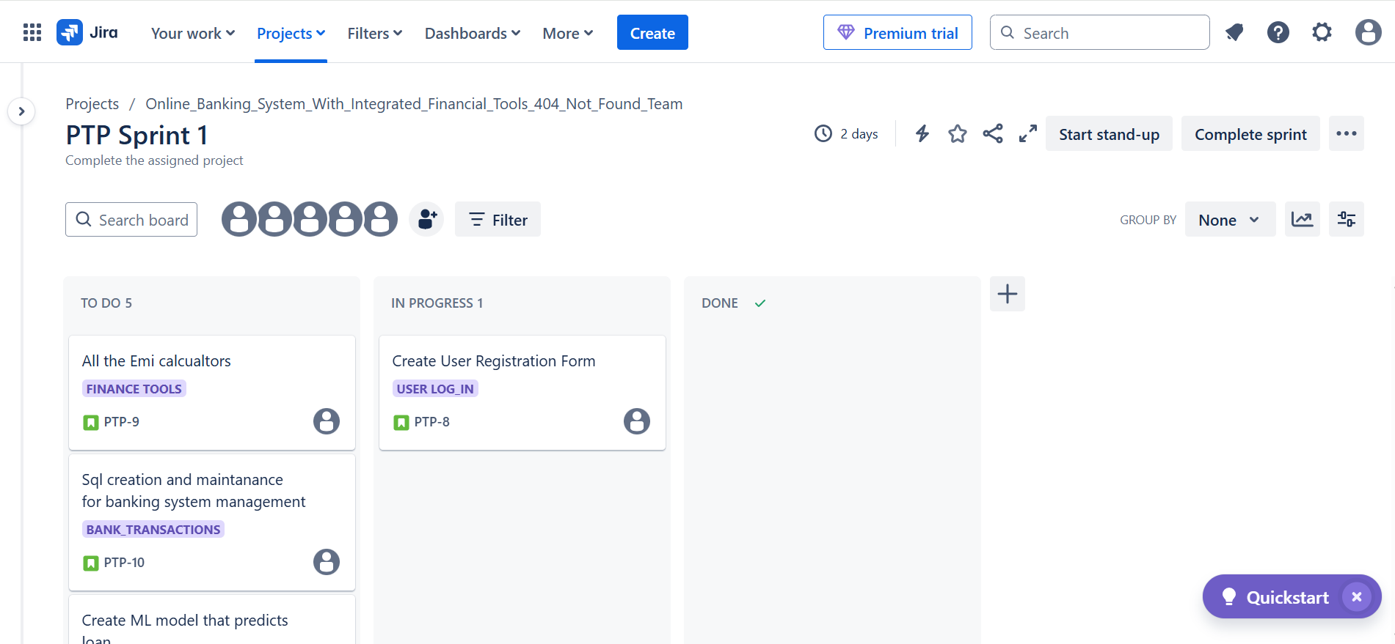
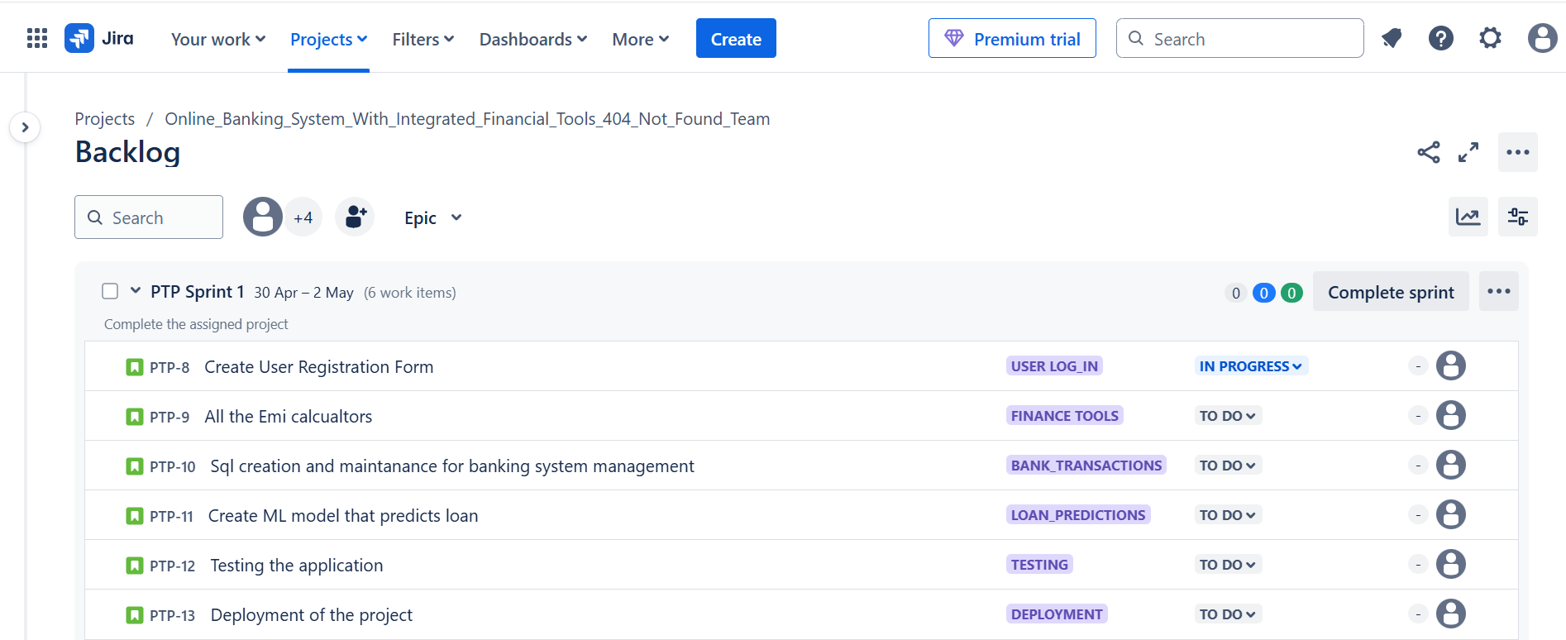
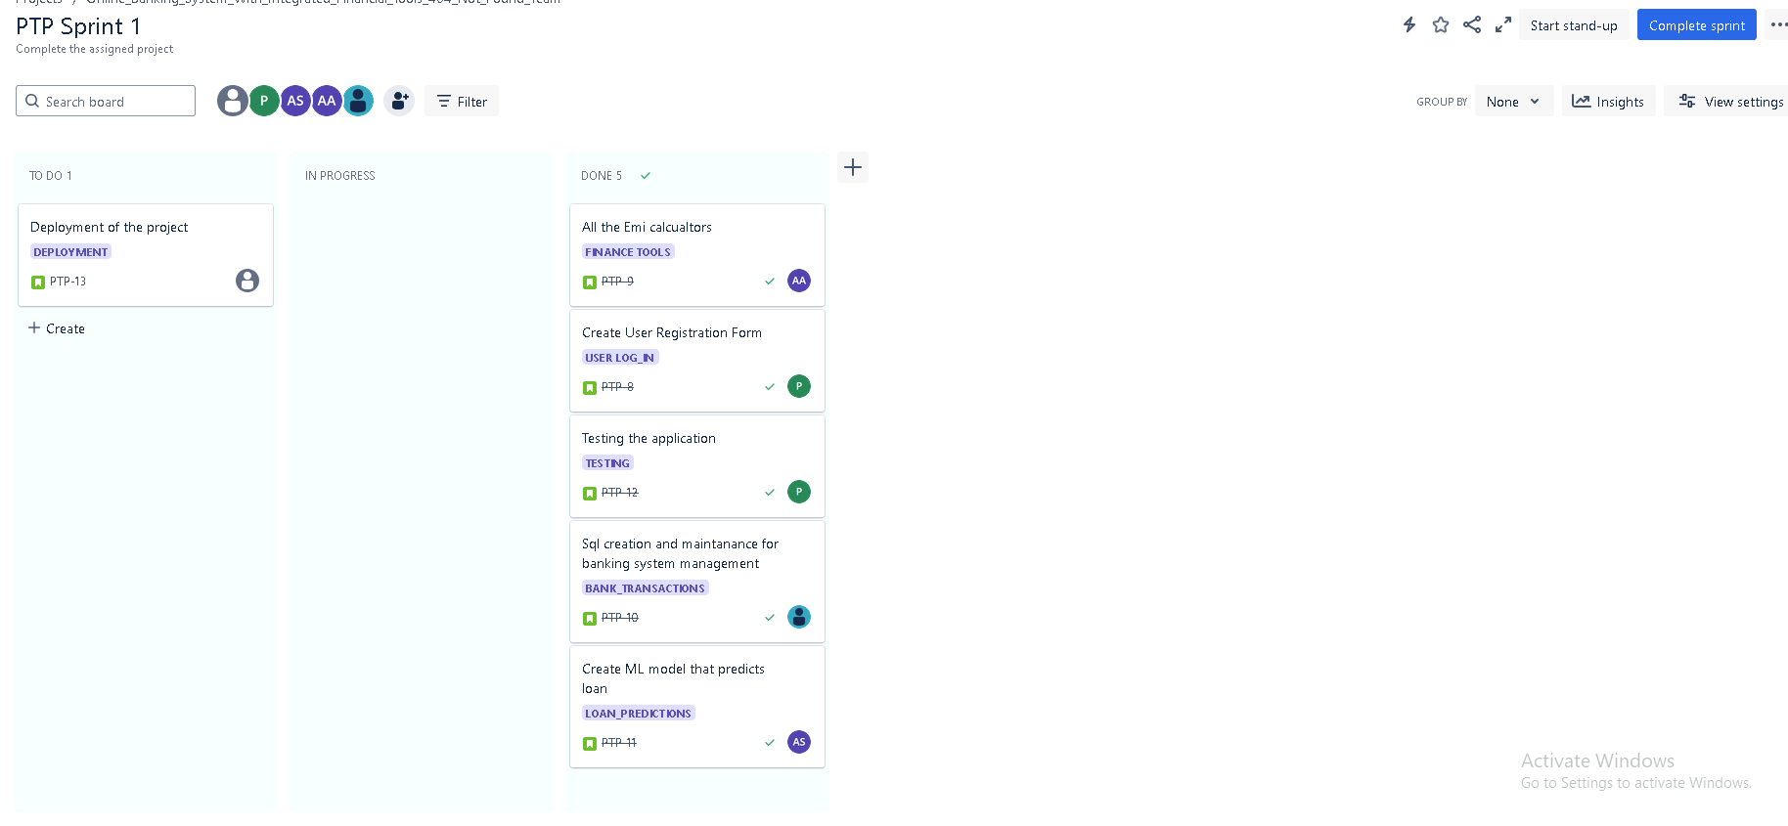
JIRA SNAPSHOT

Slide 16
FUTURE SCOPE
Funds transfer between users
Multi-currency support
Mobile-native app
Enhance UI/UX
Add Transaction history Export
Deploy
Extend ML Model

